Slide 1

Scaling Apex and LWC with Apex Cursors
Andrew Fawcett, AndyInTheCloud Consulting Ltd
andy@andyinthecloud.com
https://www.linkedin.com/in/andyfawcett/
Notes:
Why Apex Cursors?

Slide 2
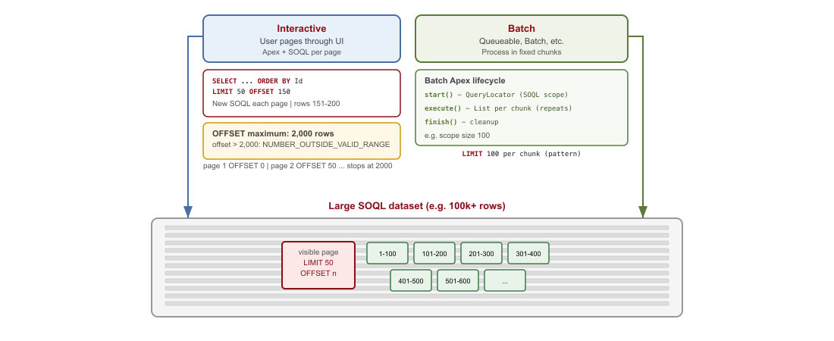
Accessing and processing datasets today in SOQL
UI paging with OFFSET/LIMIT vs async processing in fixed-size chunks.

Slide 3
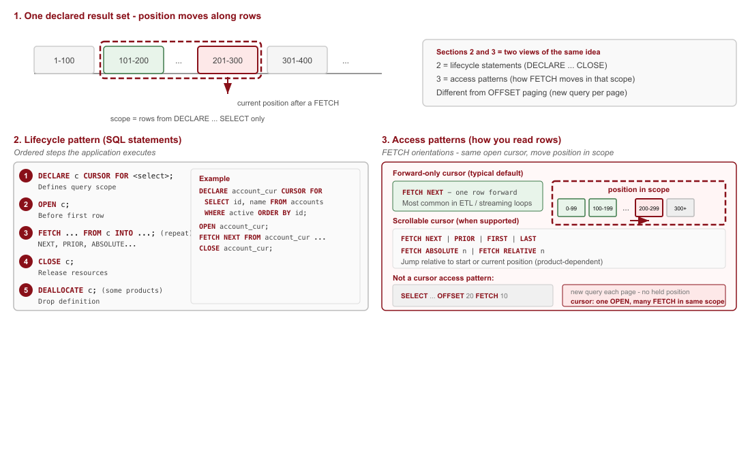
What is a SQL Cursor?
Traverse a query result incrementally instead of returning the full set at once.

Slide 4
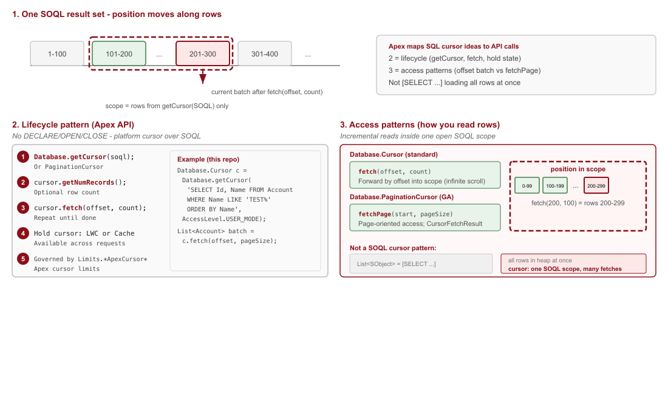
What is a SOQL Cursor?
SQL cursor concepts on Salesforce: Database.getCursor(SOQL) and incremental fetch in Apex.

Slide 5
Usecases for Apex Cursors
Interactive
Analyst large data view
Reporting and drilldown
Preview job records to process
Batch
Orchestrate process execution
Look ahead to optimize resource usage
Safer immutable record set
apex>
Database.PaginationCursor c =
Database.getPaginationCursor(
soql, AccessLevel.USER_MODE);
Database.CursorFetchResult r =
c.fetchPage(start, pageSize);
apex>
Database.Cursor c =
Database.getCursor(
soql, AccessLevel.USER_MODE);
List<Account> batch =
c.fetch(offset, pageSize);
Architecture
24hr cached large record sets | Scalable replacement to SOQL OFFSET | Bidirectional navigation

Slide 6
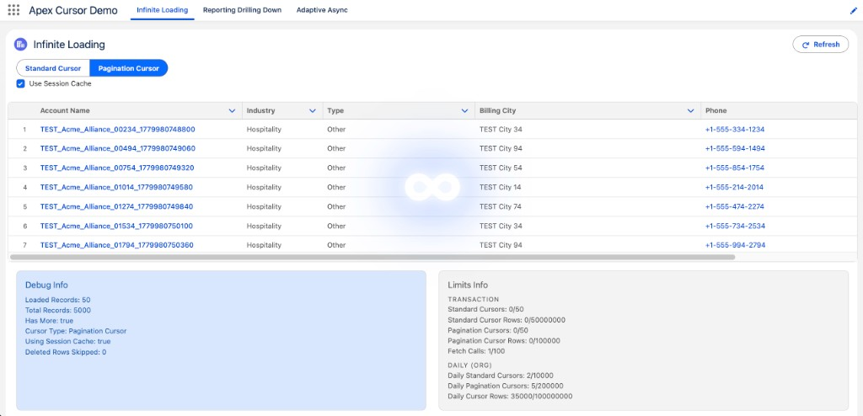
Demo 1: Virtual Data Table

Slide 7
Demo 1: Highlights
1
2
3
apex>
Database.Cursor c =
Database.getCursor(
soql,
AccessLevel.USER_MODE);
apex>
List<Account> batch =
c.fetch(offset,
batchSize);
result.hasMore =
offset < c.getNumRecords();
apex>
const result = await
loadMoreRecords({
request, useSessionCache
});
Infinite scroll loads 50 rows at a time — no SOQL OFFSET
Cursor held in LWC state or Cache.Session across Apex calls
Live limit panel surfaces cursor, fetch, and row governor usage
Switch between standard and pagination cursor modes in one LWC

Slide 8
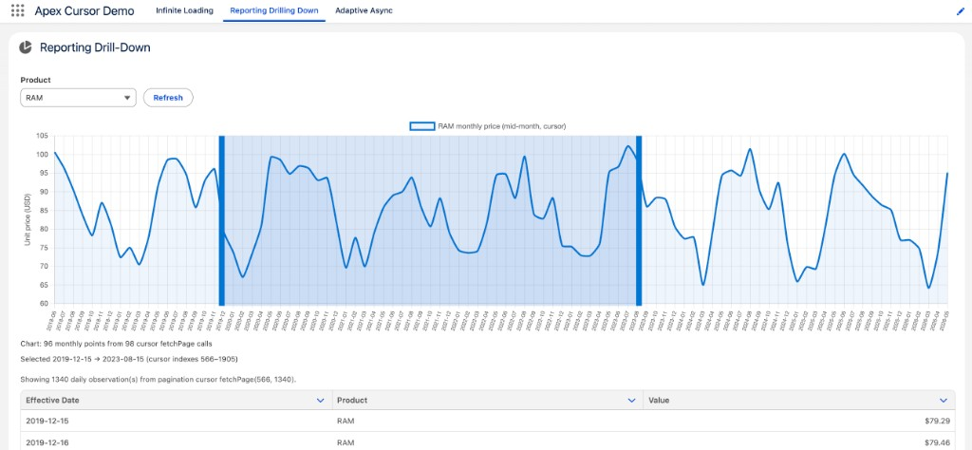
Demo 2: Interactive Reporting and Drilldown

Slide 9
Demo 2: Highlights
1
2
3
apex>
Database.PaginationCursor pc =
Database.getPaginationCursor(
soql,
AccessLevel.USER_MODE);
Cache.Session.put(
sessionKey(product), pc);
apex>
fetchResult = pc.fetchPage(
dayIndex, 1);
deletedRows =
fetchResult
.getNumDeletedRecords();
apex>
const detail = await
fetchDetailRange({
product,
startIndex, endIndex
});
PaginationCursor builds the monthly chart with one fetchPage per month
Session cache keeps the cursor for brush-selection drill-down
Index-based fetchPage maps chart range to daily observation rows
fetchPage reports deleted rows when underlying data changes

Slide 10
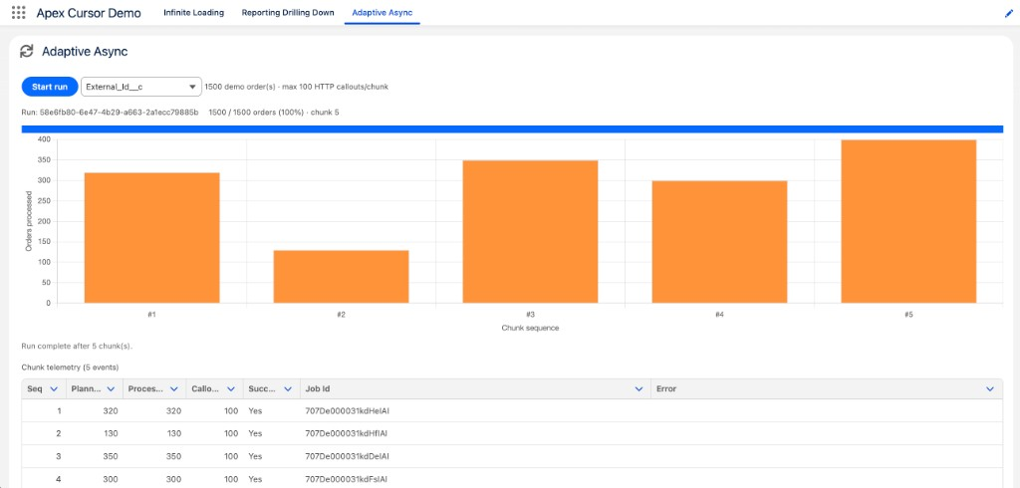
Demo 3: Adaptive Async

Slide 11
Demo 3: Highlights
1
2
3
apex>
Database.Cursor cursor =
Database.getCursor(
soql,
AccessLevel.USER_MODE);
System.enqueueJob(
new AdaptiveOrderWorkerQueueable(
runId, cursor, 1), options);
apex>
for (Order row :
cursor.fetch(pos,
batchSize)) {
rowCallouts =
rowCalloutsFor(row);
// pack to callout budget
apex>
if (moreOrders) {
sequence++;
System.enqueueJob(this);
}
System.attachFinalizer(this);
One cursor opened in Apex and passed through chained queueable jobs
Chunk size adapts to remaining HTTP callout budget per transaction
Finalizer publishes platform events after each chunk commits
Cursor position travels on the job — no Database.Stateful required

Slide 12
Limits
Limit
Pagination
Standard
Cursors (per transaction)
50
50
Max rows per cursor
100,000
50,000,000
Fetch calls (per transaction)
100
100
Daily cursors (per org)
200,000
10,000
Daily cursor rows (per org)
1,000,000,000
1,000,000,000
Max rows per cursor caps each cursor's result set size — not a per-transaction row governor.
Fetch calls are shared: Cursor.fetch and PaginationCursor.fetchPage both count toward the 100-call limit.

Slide 13
Tips and Tricks
Practical patterns from the Apex Cursor demos
Instrument limits first
Show cursor, fetch, and row limits in the UI before users hit governor walls.
Session cache vs LWC state
Cache.Session survives Apex calls; LWC-held cursor avoids server-side state.
🔍
📦
Pagination for drill-down
PaginationCursor + fetchPage for deleted rows and chart index ranges.
Stable ORDER BY
Sort on a unique key so offsets and page indexes stay predictable.
📄
📐
Right-size each fetch
Smaller batches feel snappier; larger batches mean fewer fetch calls.
USER_MODE by default
Pass AccessLevel.USER_MODE on getCursor unless elevated access is required.
⚡
🛡️

Slide 14
Q&A
Andrew Fawcett
andy@andyinthecloud.com | LinkedIn

Slide 15
Thank You
Andrew Fawcett
andy@andyinthecloud.com | LinkedIn

